Slide 1


Slide 2
Affordable Housing Development Gap Subsidy Program -
Grantee Workshop
Larisa Stout, Housing Programs Manager
NOVEMBER 19th, 2025

Slide 3
The TEAM
Director of Community Housing – Bill Lord
Community Housing Programs Manager – Larisa Stout
Senior Housing Program Coordinator – Evelyn Finch
Senior Housing Program Coordinator – Maree Emberton

Slide 4
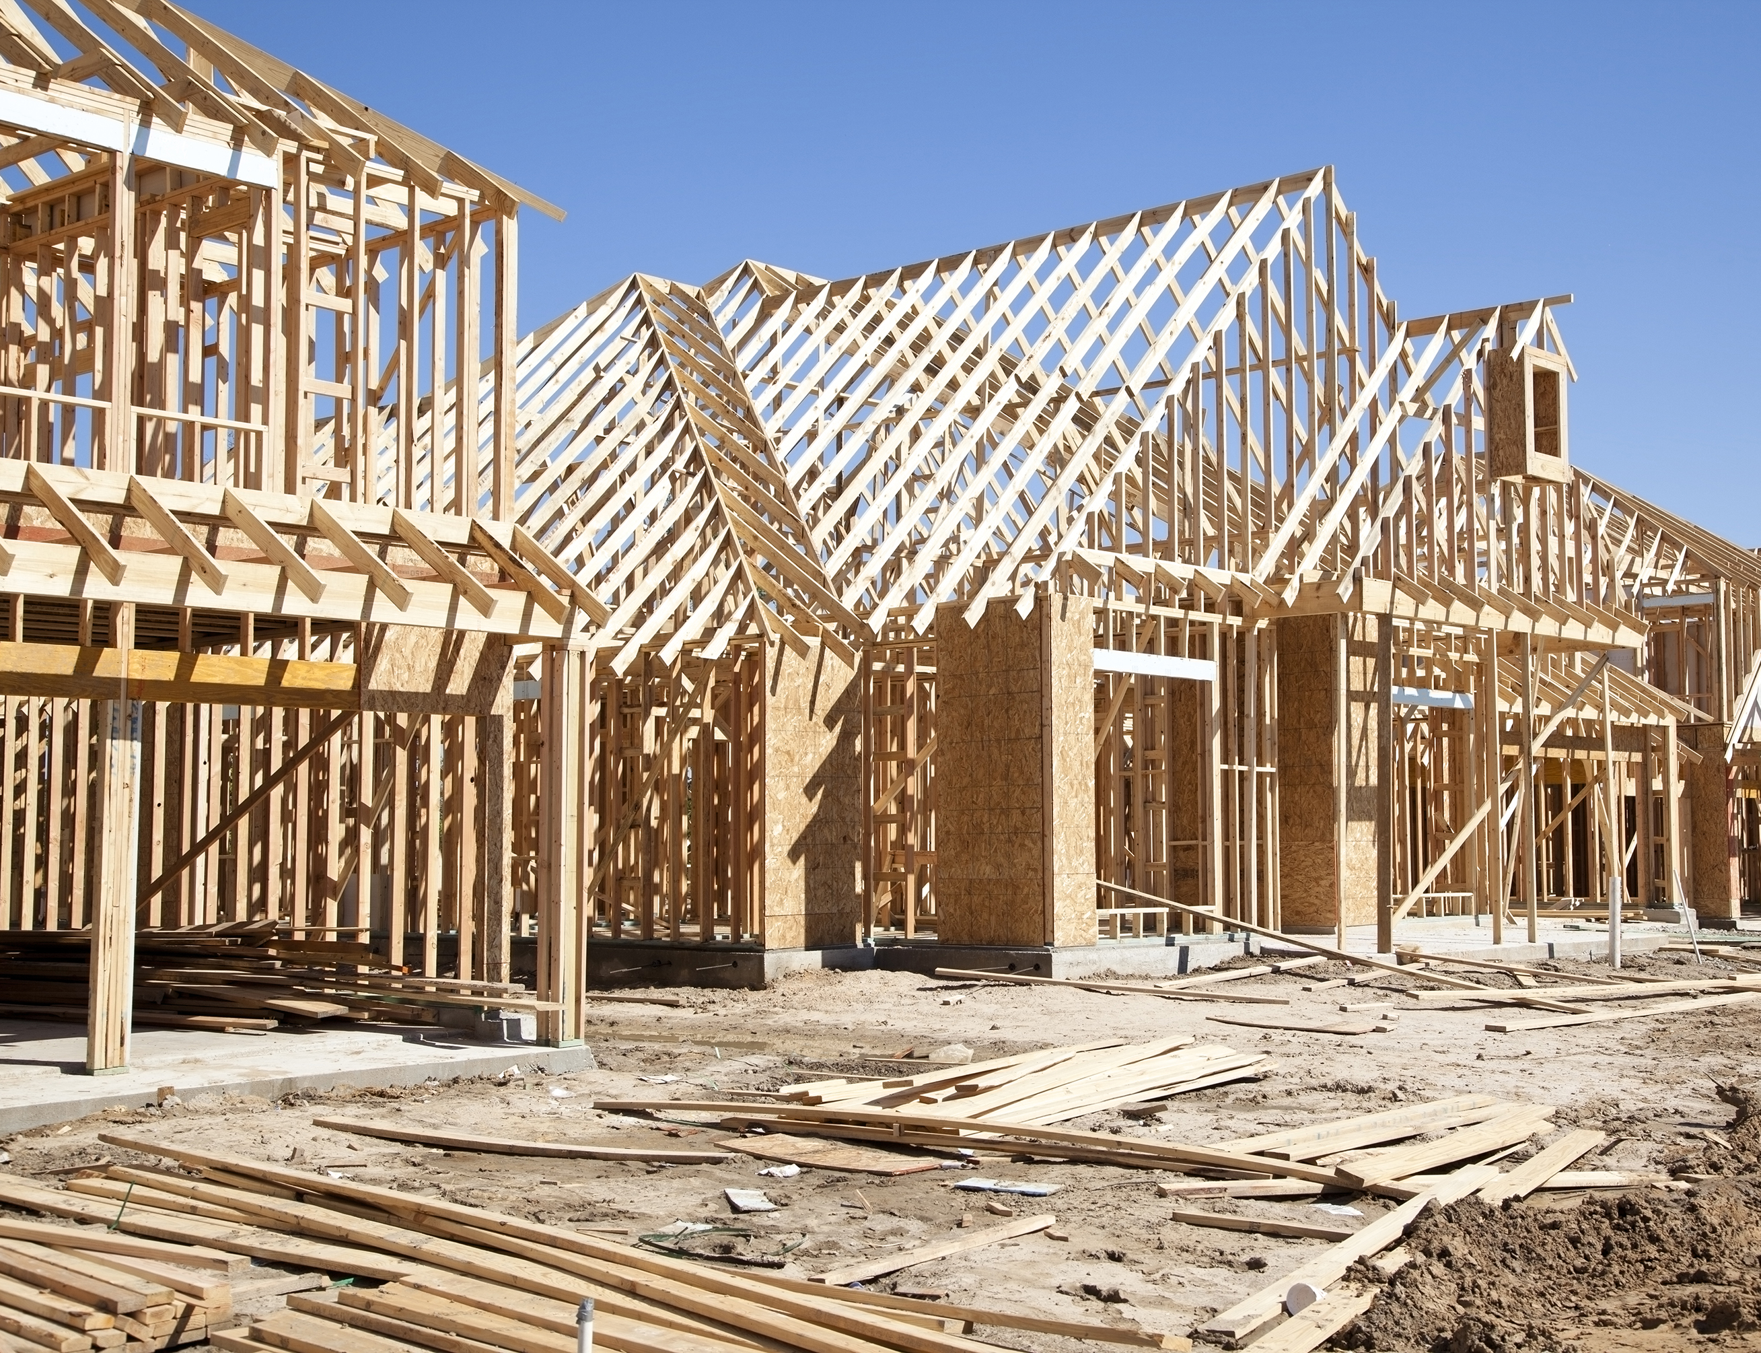
WELCOME AWARDEES
UNITED HOUSING INC.
HABITAT FOR HUMANITY OF GREATER MEMPHIS
ALLCY BALL DEVELOPMENT CORPORATION
HABITAT FOR HUMANITY WILLIAMSON/MAURY

Slide 5

Agenda Items
Program Purpose and Overview
Reservation of Funds Letter
Eligible Activities
Prohibited Activities
Property Standards and Universal Design/Visitability
Equal Opportunity, Fair Housing, and Conflict of Interest
Allocation of Funds/Revised Payment Options
Forms
Document Submission Instructions – EDT Secure Site
Q&A

Slide 6
Program Purpose Overview
The Tennessee Housing Trust Fund (THTF) promotes the production, preservation, and rehabilitation of housing for low to moderate income households across Tennessee. The Affordable Housing Development Gap Subsidy Program will be funded with a total of $3,000,000 from the THTF. The Program addresses the financial challenge that arises when the cost of developing new homes exceeds their appraised value, a common barrier in economically distressed communities. By bridging this development gap, the Program aims to promote homeownership, stabilize neighborhoods, and gradually improve property appraisal values.

Slide 7
Program Purpose Overview
As part of this initiative, THDA is requiring that initial home prices be set slightly above appraised value by approximately 3% to 6%, providing a seller credit to ensure the net purchase price realized by the low to moderate income buyer aligns with the appraised value. Buyers will remain responsible for all applicable closing costs and financing fees. THDA will provide the funds at or after closing on a house-by-house basis on qualifying new builds with up to a maximum subsidy of $70,000 (Seventy Thousand dollars) per unit to cover the Development Gap.
This approach is designed to help organically increase appraisal values over time, better aligning them with the true cost of development. By strategically subsidizing development, adjusting pricing and offering direct support to buyers, THDA aims to stimulate affordable housing production in these underserved areas while gradually improving market conditions.

Slide 8
Reservation of Funds Letter
Updated Reservation of Funds Letters were emailed last week by Legal to all Grantees for approval
Effective date of the reservation: NOVEMBER 1, 2025
Date Reservation expires: OCTOBER 31, 2027
Grantees shall newly construct up to TEN (10) units of single-family housing for sale to low- and moderate-income homebuyers (up to 120% of the AMI for the area where the home will be developed.)
The Reservation of Funds Letter must be executed NO LATER THAN THE END OF BUSINESS ON NOVEMBER 30, 2025.

Slide 9
Eligible Activities
Eligible housing activities under the 2025 Development Gap Subsidy Program include:
Costs to Develop Units:
Program funds must be used to subsidize the cost to develop single-family units for homeownership and is limited to new construction only. Grant Recipients must be the owner and developer of the units at the time the units are constructed.
b. Sales Price:
  All units must have a final sale price of between 3 and six percent (3%-6%) above the final appraised value of the home. The final amount will be determined by the policies of the first mortgage provider.
Seller Credit:
When units are sold to eligible homebuyers, the developer/seller must provide funds as a seller credit to reduce the buyer’s obligation to no more than the appraised value of the home, plus all applicable buyer fees and closing costs.

Slide 10
Eligible Activities (cont.)
d. Permanent Financing:
THDA expects the use of THDA mortgage loans whenever suitable. Other financing may be used if it is comparable to a THDA mortgage loan. All loans must have a fixed interest rate fully amortizing over the 30-year term of the loan. There can be no pre-payment penalty for early payoffs.
e. Qualified Homebuyer:
All homebuyers must be at or below 120% of the AMI for the area where the home is developed.
f. Developer Fees:
A grant recipient may include a 10% developer’s fee in the cost to develop the home.
g. Homebuyer Education:
All homebuyers must complete a homebuyer education program from a THDA- qualified homebuyer education provider prior to purchase.

Slide 11
Prohibited Activities
Program funds CANNOT be used for:
1. The purchase and installation of manufactured housing on lots
2. The Acquisition and/or rehabilitation of existing housing units
3. To develop rental housing units
4. To construct housing in an area identified by the Federal Emergency Management Agency as having special flood hazards

Slide 12
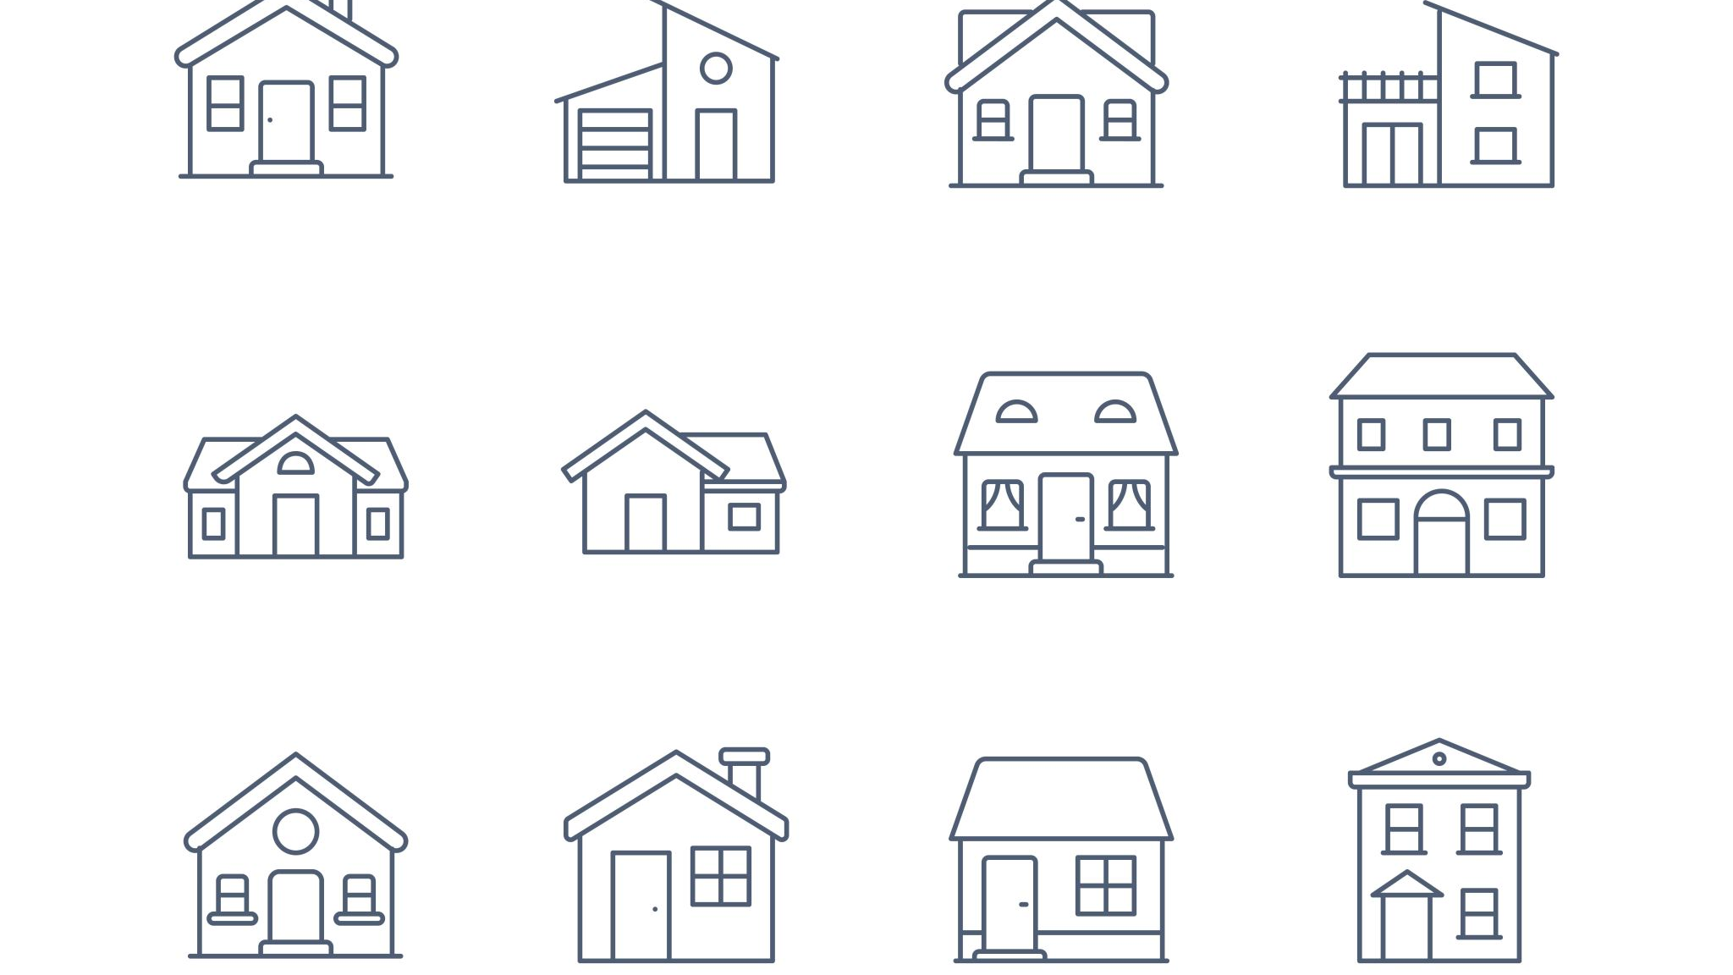
Property Standards and
Universal Design/Visitabilty

Slide 13
Property Standards
Any housing constructed with Program funds must meet all applicable local, county, and state codes at the time of project completion.
In the absence of a local code, new construction of single-family units or duplexes must meet the current, State-adopted edition of the International Residential Code for One- and Two-Family Dwellings. The newly constructed units must also meet accessibility requirements and mitigate disaster impact as applicable per State and local codes, ordinances, etc.
Units must be built in a jurisdiction where the unit can be inspected by a state certified building inspector or by a provider as permitted under State law.

Slide 14
Universal Design/Visitability
THDA encourages the inclusion of features that allow individuals with physical disabilities to reside and/or visit the housing that is constructed with Development Gap Subsidy funds.
Universal design is a building concept that incorporates products, general design layouts and other characteristics to a housing unit in order to:
• Make the unit usable by the greatest number of people;
• Respond to the changing needs of the resident; and,
• Improve the marketability of the unit.

Slide 15
Universal Design/Visitability (cont.)
The goal of universal design seeks to build housing that meets the needs of the greatest number of residents within a community. Universal design differs from accessible design, which is primarily intended to meet the needs of persons with disabilities. However, universal design is inclusive of adaptable design as universal design incorporates structural features that will allow a housing unit to be adapted to an individual’s current or future needs. Universal design features include, but are not limited to:
• Stepless entrances.
• Minimum 5’ x 5’ level clear space inside and outside entry door.
• Broad blocking in walls around toilet, tub and shower for future placement of grab bars.
• Full-extension, pull-out drawers, shelves and racks in base cabinets in kitchen.
• Front mounted controls on all appliances.
• Lever door handles.
• Loop handle pulls on drawers and cabinet doors.
More information on Universal Design may be found at The Center for Universal Design at North Carolina State University: http://www.ncsu.edu/ncsu/design/cud/index.htm.

Slide 16
Universal Design/Visitability (cont.)
Visitability refers to homes that are designed and built in a manner that allows individuals who have trouble with steps or use wheelchairs or walkers to live in or visit the unit. These features include:
• One zero-step entrance
• Doors with 32 inches of clear passage space
• One bathroom on the main floor that is accessible to a person using a wheelchair
More information on Visitability can be found at: http://www.visitability.org.

Slide 17
Equal Opportunity & Fair Housing/Conflict of Interest
EQUAL OPPORTUNITY AND FAIR HOUSING
Grant Awardees must meet all applicable Equal Opportunity and Fair Housing laws and regulations.
CONFLICT OF INTEREST
Recipients of Program Funds should avoid conflicts of interest and the appearance of conflicts of interest in administering the Program. The existence of a conflict of interest or the appearance of a conflict of interest, as determined by THDA in its sole discretion, may be grounds for requiring repayment Program funding and limitations on future program participation.

Slide 18
Allocation of Funds/Revised Payment Options

Slide 19
Allocation of Funds
  Funds are being committed to this program description by THDA though the TNHTF. Additionally, THDA may make available any returned or leftover funds from this allocation or add additional funding from TNHTF or other THDA resources should THDA determine additional funding is available.
  Lack of Ability to Comply. If, in the opinion of THDA, all applicants lack the organizational potential to successfully develop and sell housing affordable to qualified low-income homebuyers, THDA may at its sole discretion, choose not to award all or any of the funds made available under this program description.
  2. THDA may also offer a reduced amount of funding in the Reservation than outlined herein, in its sole discretion.

Slide 20
Allocation of Funds – Funding Requirements
  Funding Requirements: Program awards will be in the form of direct payment, on a house-by-house basis, at the time of closing of the sale to the low-moderate income home buyer. Non-profit Developer/Seller agrees to provide THDA a preliminary closing statement and required disclosure document no less than 10 Calendar Days prior to the expected closing and a final closing statement no less than 72 hours prior to the scheduled closing.
  THDA will wire funds for closing directly to the closing/title organization on or before the date of final closing.
  OR
  THDA will also reimburse approved Non-profit Developer/Sellers for otherwise eligible sales after closing, if the closing occurred within the Term of the Reservation of Funds upon receipt of the requisite documentation.

Slide 21
Forms for Reimbursement and Submission Requirements

Slide 22
Forms
  Form 1 - Authorized Signature Authorization
  Pay Request Checklist
  Form 5 - Request for Payment Form

Slide 23
Development Gap Subsidy Program:
Signature Form
*only need at grant start up and if the signatories change during the grant period

Slide 24
Development Gap Subsidy Program:
Pay Request Checklist

Slide 26
6. ☐ CHECK BOX WHEN REQUESTING FUNDS AT CLOSING
Note: The following items are required a minimum of 10 calendar days before closing:
  Preliminary closing statement and required disclosure document showing seller credit for the amount above appraisal
  Title agent information including contact person and wiring instructions
☐ FINAL Closing statement required a MINIMUM of 3 days prior to closing
7. ☐ CHECK BOX WHEN REQUESTING FUNDS POST CLOSING
☐ FINAL Closing statement
Reserved for THDA
____________________________________________________________
Date Received by THDA: _________________________________
Date Sent to Accounting for payment: ______________________

Slide 27
Development Gap Subsidy Program:
Form 5 –Request for Payment Form

Slide 31
Submission Instructions
Documents for payment submission should be uploaded to the secure EDT – Web Transfer Client System site
    Please upload in one pdf document if possible
    Please use the checklist as a guide for the order of documents in the upload
    After submitting the upload, please email THDA
    (we do not get notifications internally about uploads)

Slide 32
TEAM Contact Information
Larisa Stout – CH Programs Manager
lstout@thda.org
(615)815-2093
Maree Emberton – CH Senior Housing Programs Coordinator
memberton@thda.org
(615)815-2031
Evelyn Finch – CH Senior Housing Programs Coordinator
efinch@thda.org
(615)815-2109
https://thda.org/govt-non-profit/affordable-housing-development-gap-subsidy/

Slide 33

QUESTIONS

